Slide 1
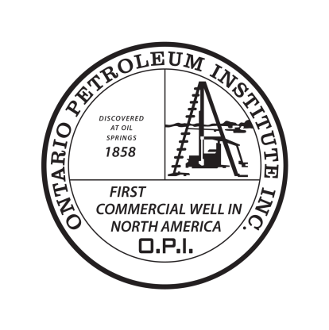
Ontario Petroleum Institute Booth #2060
The Ontario Advantage
Ontario, Canada

Slide 2
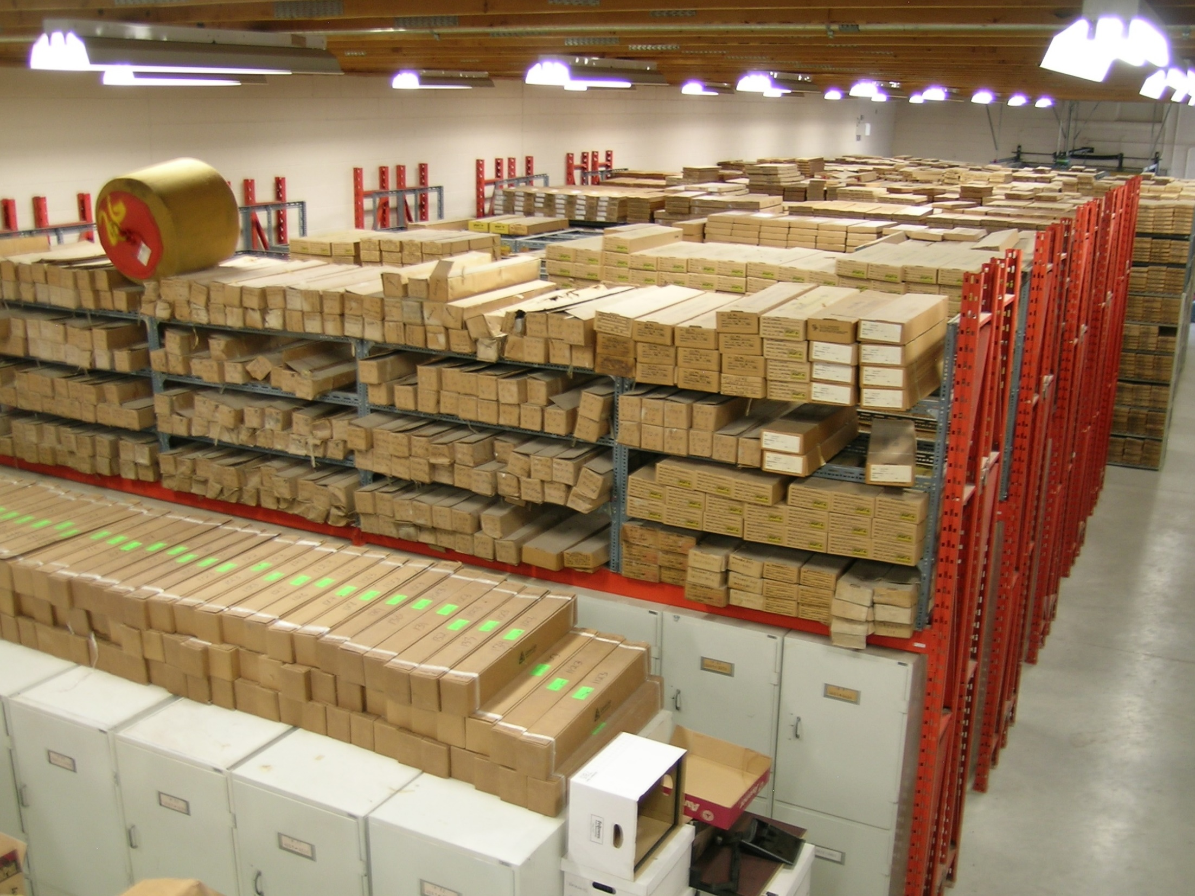
ONTARIO PETROLEUM INSTITUTE
The Ontario Petroleum Institute (OPI) is the industry association representing oil and natural gas exploration, production and hydrocarbon storage in southwestern Ontario.
The OPI promotes Ontario as a profitable exploration and development opportunity, encouraging companies to consider The Ontario Advantage.
Ontario’s oil and natural gas industry is open to partnering with companies interested in developing Ontario’s natural resources.
Ontario is home to what is often referred to as a “jewel” in the province’s energy industry ― the Oil, Gas and Salt Resources Library.
The Library is an important resource centre offering the most current geological information for the exploration and development of crude oil and natural gas.
100% of Ontario’s recorded well files and geophysical logs are available online. Start exploring from your office with a free membership at: www.ogsrlibrary.com/free

Slide 3
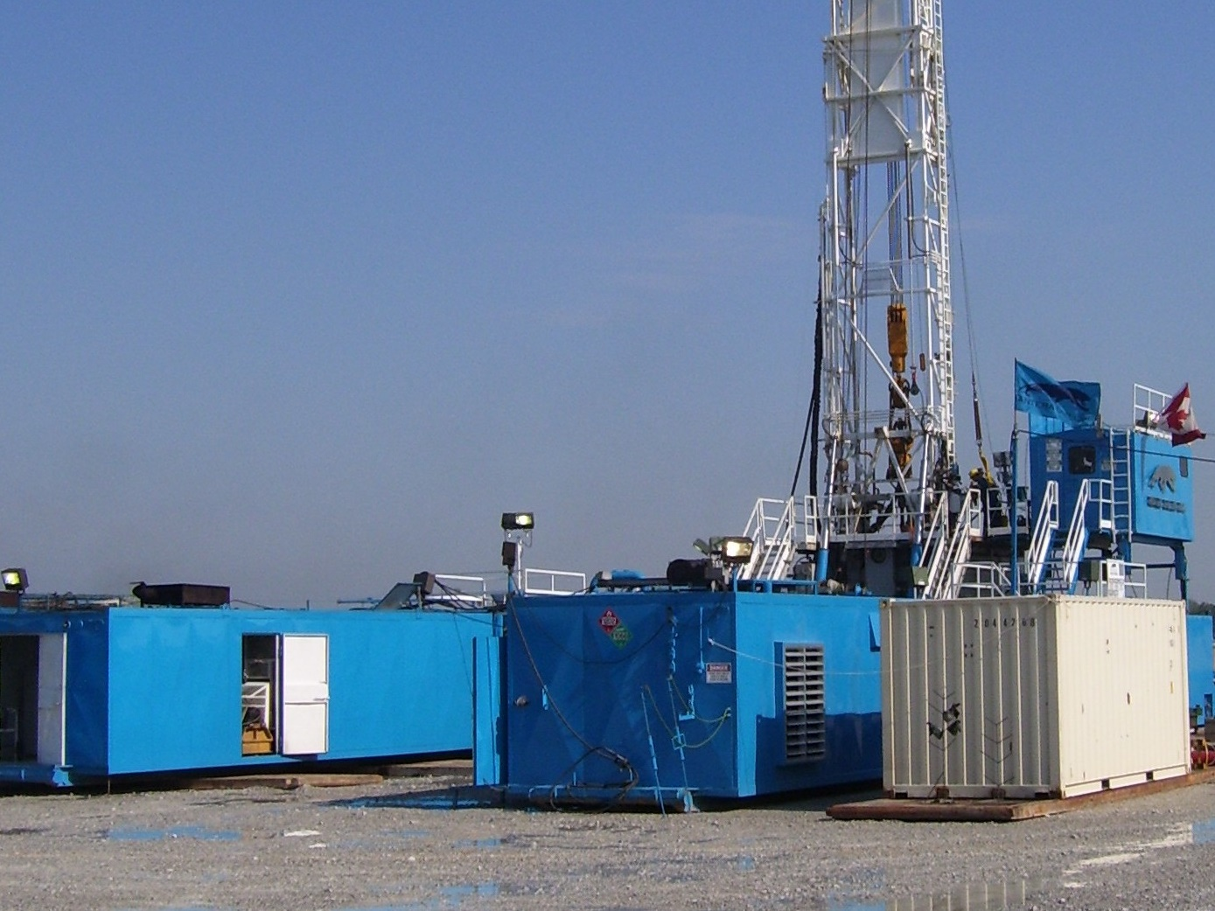
EXPLORATION AND PRODUCTION
50% OF THE RECOVERABLE OIL AND NATURAL GAS REMAINS TO BE DEVELOPED
HIGH NETBACKS
87.5% NRI
LOW LEASING COSTS
SHALLOW RESOURCES

Slide 4
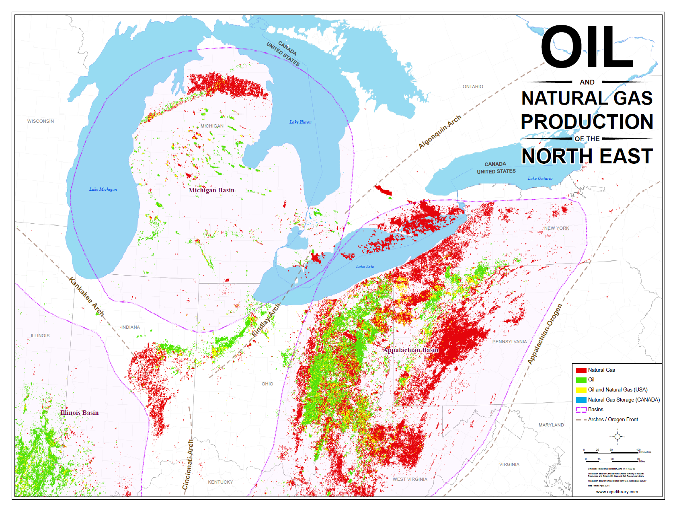
EXPLORATION AND PRODUCTION
190 MMbbl
Undiscovered Oil
1.2 TCF
Undiscovered Natural Gas
Conventional reserves are found in Southwestern Ontario reservoirs with potentially 190 million barrels of undiscovered crude oil and 1.2 TCF of natural gas in the Michigan and Appalachian sedimentary basins.

Slide 5
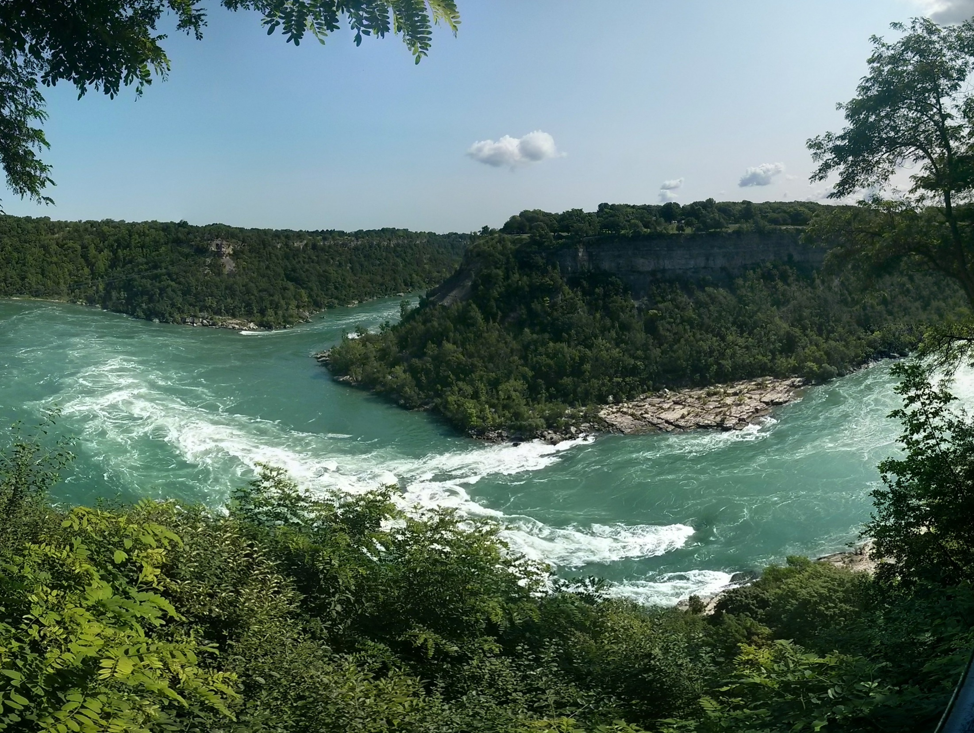
EXPLORATION AND PRODUCTION
Oil and Natural Gas Plays
Structural traps in fractured and dolomitized carbonates and sandstones - Devonian 400-500’
Stratigraphic traps in sandstones and carbonates – Silurian; offshore Lake Erie 200-2000’
Reefs and structural traps in carbonates – Middle Silurian; onshore 1500-2100’
Hydrothermal dolomite reservoirs in limestones – Middle Ordovician 2200-3000’; and
Structural and stratigraphic traps in sandstones and sandy dolomites – Cambrian 2300-4000’

Slide 6
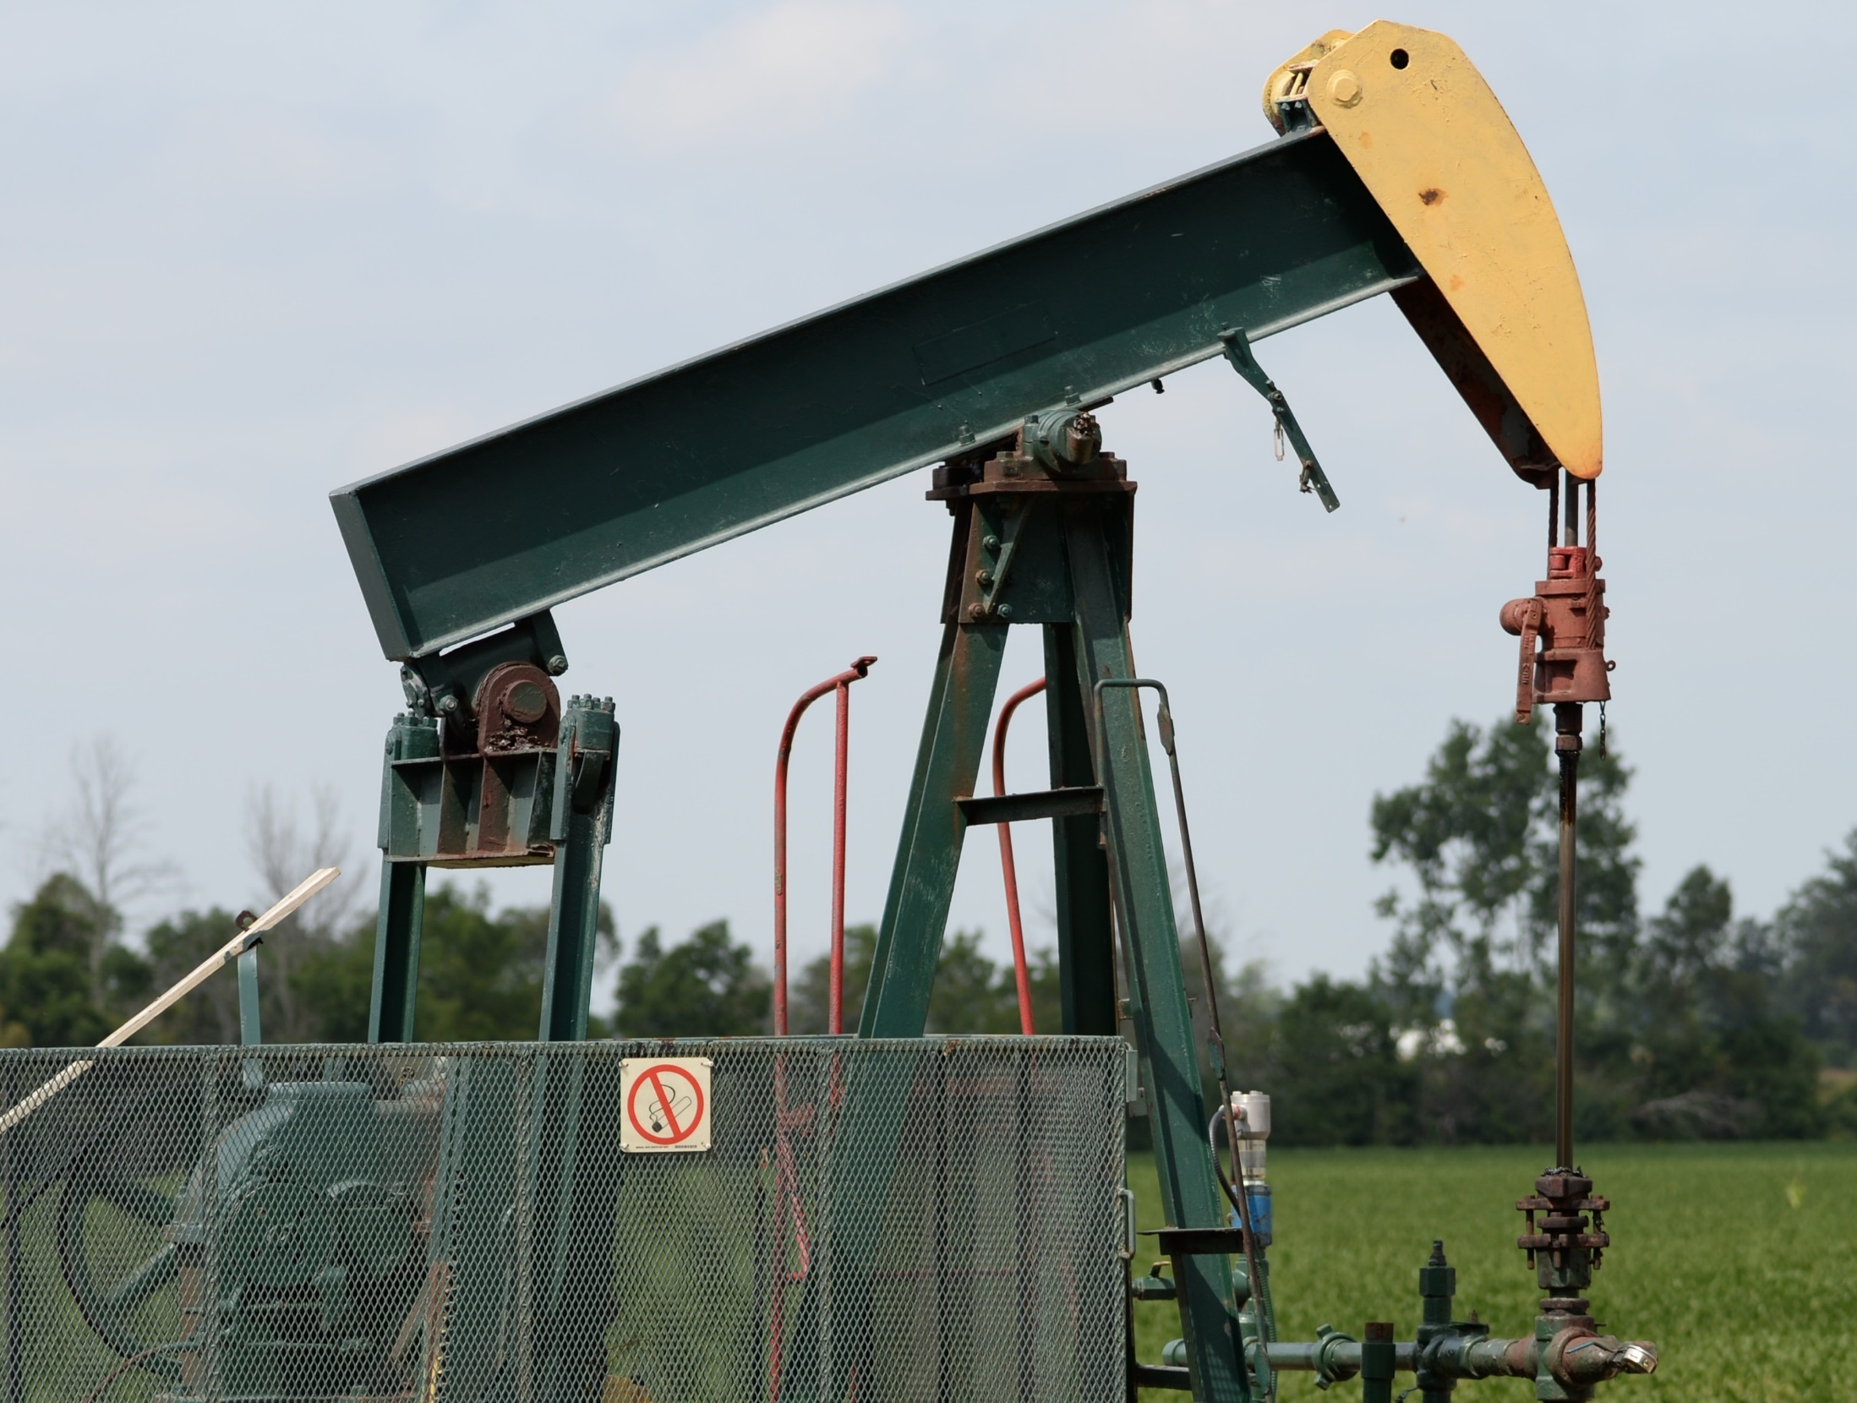
EXPLORATION AND PRODUCTION
ESTABLISHED AND POTENTIAL RESERVES OF OIL & NATURAL GAS
PROJECTED GROWTH IN ONTARIO DEMAND FOR OIL & NATURAL GAS

Slide 7
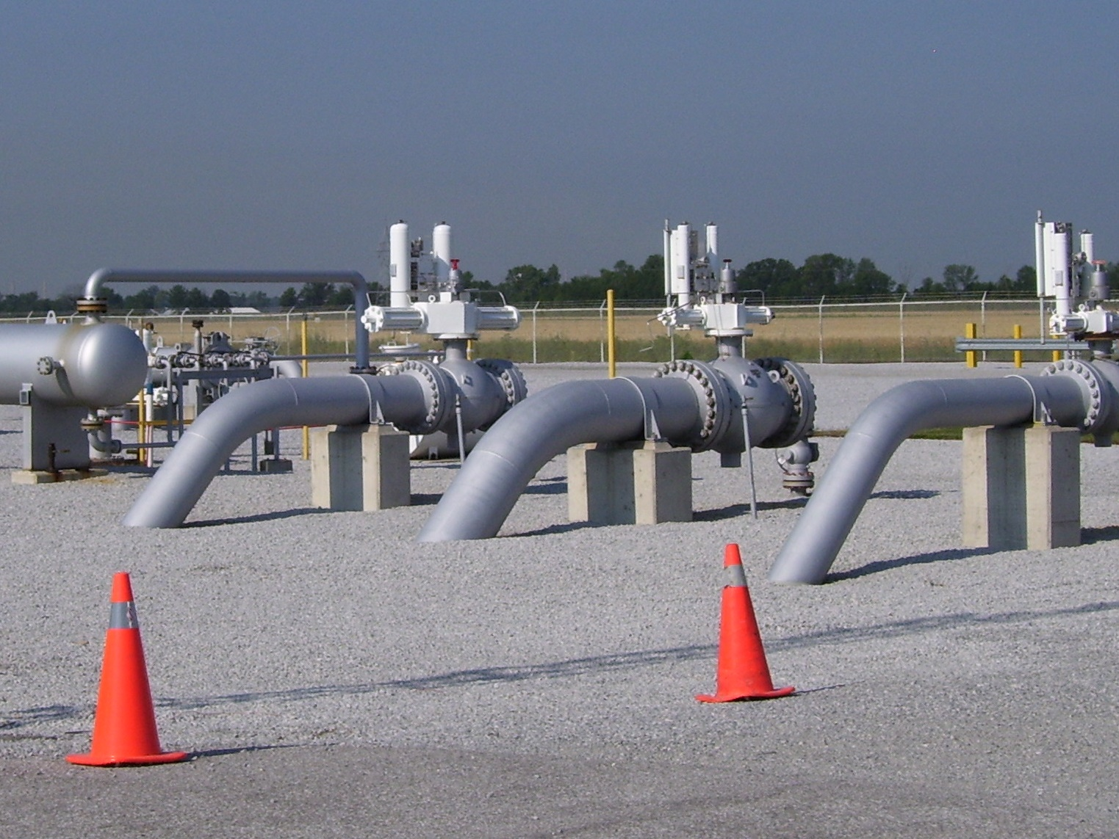
INFRASTRUCTURE
DRILLING AND SERVICE RIGS
TRANSPORTATION
Trucking and pipelines
OIL REFINERIES
4 Refineries; 390 000 bbl/d capacity
20% of the Canadian refining capacity
HYDROCARBON STORAGE
258 BCF Natural gas storage – 28 pinnacle reefs
22 MMbbl Liquified Petroleum – Salt Caverns
DRILLING
Ontario has considerable experience in drilling for energy resources. Innovations continue to provide drilling capability that is at the forefront of exploration and production.
TRANSPORTATION
The industry is supported by a network of road infrastructure providing access to drilling and wellhead operations. Oil is trucked to market directly and a network of pipelines flow natural gas to distributors.
OIL REFINERIES
Ontario has four refineries with a combined crude oil processing capacity of 390,000 barrels per day representing approximately 20% of total Canadian refining capacity.
HYDROCARBON STORAGE
Natural gas demand is met with storage capacity of 258.4 billion cubic feet in depleted gas reservoirs, and includes one of the largest underground storage facilities in North America.
solution-mined caverns in salt beds are utilized for underground storage of liquefied hydrocarbons and petrochemicals at the refineries and petrochemical plants at Windsor and in the Sarnia area, with total capacity of 22 million barrels

Slide 8
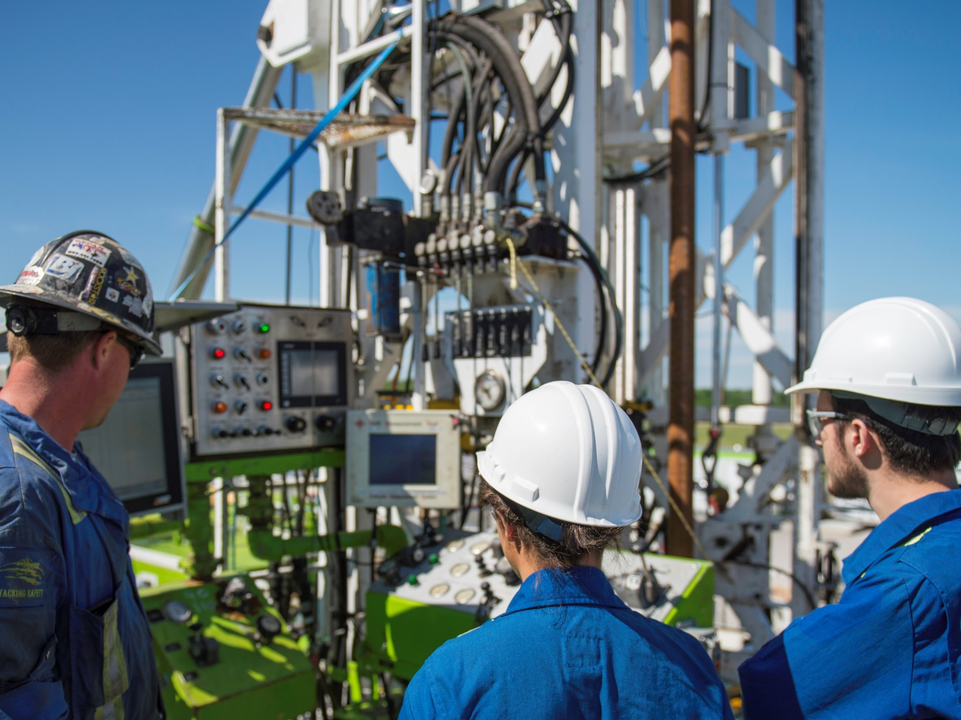
EXPERIENCE AND EXPERTISE
Ontario companies are ready to provide you with an experienced and educated workforce ready to tap our exploration and development potential
`
Experience Support Firms
Oilfield Services 50
Consultants 30
Professional Services 12
Leasing, Land Companies & Surveys 10
Drilling Contractors 9
Service and Support 5

Slide 9
Ontario Petroleum Institute
Booth Number 2060
Ian Colquhoun and Hugh Moran
203-555 Southdale Road East
London, Ontario N5P 3T2
Canada
opi@ontariopetroleuminstitute.com
(519) 680-1620

